Slide 1

INSTITUTE - UIE
DEPARTMENT- ACADEMIC UNIT-2
Bachelor of Engineering (Computer Science & Engineering)
Subject Name: Introduction to Problem Solving
Code:22CSH-101
Pointers: Functions returning Pointer, Storage Classes
DISCOVER . LEARN . EMPOWER

Slide 2


Introduction to Problem Solving
Course Objectives
The course aims to provide exposure to problem-solving through programming.
The course aims to raise the programming skills of students via logic building capability.
With knowledge of C programming language, students would be able to model real world problems.

Slide 3



Course Outcomes
CO Number | Course Outcome
CO1 | Remember the concepts related to fundamentals of C language, draw flowcharts and write algorithm/pseudocode.
CO2 | Understand the way of execution and debug programs in C language.
CO3 | Apply various constructs, loops, functions to solve mathematical and scientific problem.
CO4 | Analyze the dynamic behavior of memory by the use of pointers.
CO5 | Design and develop modular programs for real world problems using control structure and selection structure.

Slide 4
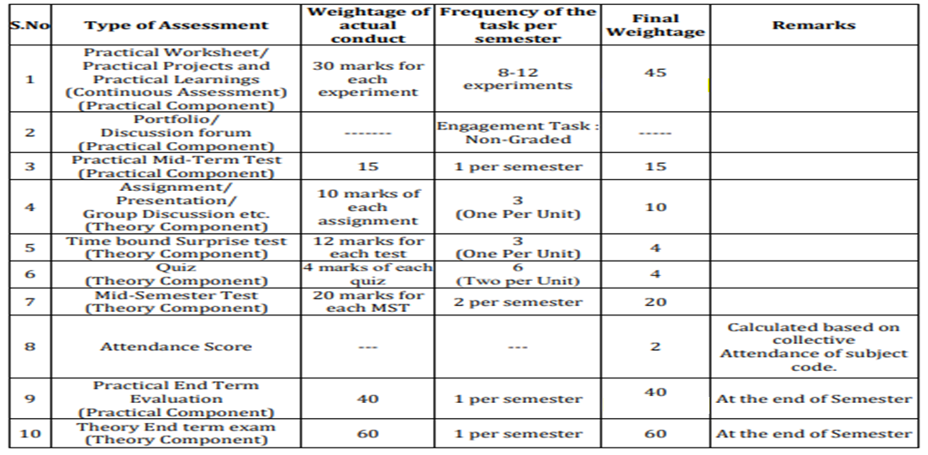
Scheme of Evaluation

Slide 5
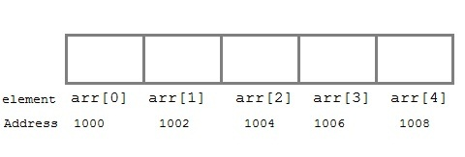
Pointers and Arrays
When an array is declared, compiler allocates sufficient amount of memory to contain all the elements of the array.
Base address i.e address of the first element of the array is also allocated by the compiler.
Suppose we declare an array arr,
int arr[5] = { 1, 2, 3, 4, 5 };
Assuming that the base address of arr is 1000 and each integer requires two bytes, the five elements will be stored as follows:
Here variable arr will give the base address, which is a constant pointer pointing to the first element of the array, arr[0]. Hence arr contains the address of arr[0] i.e 1000. In short, arr has two purpose - it is the name of the array and it acts as a pointer pointing towards the first element in the array.
arr is equal to &arr[0] by default

Slide 6
We can also declare a pointer of type int to point to the array arr.
int *p;
p = arr;
// or,
p = &arr[0]; //both the statements are equivalent.
Now we can access every element of the array arr using p++ to move from one element to another.
NOTE: You cannot decrement a pointer once incremented. p-- won't work.

Slide 7
Pointer to Array
As studied above, we can use a pointer to point to an array, and then we can use that pointer to access the array elements.
Lets have an example,
#include <stdio.h>
int main()
{
int i;
int a[5] = {1, 2, 3, 4, 5};
int *p = a; // same as int*p = &a[0]
for (i = 0; i < 5; i++)
{
printf("%d", *p);
p++;
}
return 0;
}
In the above program, the pointer *p will print all the values stored in the array one by one. We can also use the Base address (a in above case) to act as a pointer and print all the values.

Slide 8
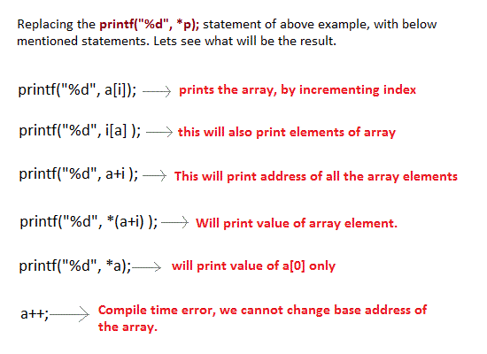
The generalized form for using pointer with an array *(a+i) is same as a[i].
Source: https://www.studytonight.com/c/pointers-with-array.php

Slide 9
Pointer to Multidimensional Array
A multidimensional array is of form, a[i][j].
Lets see how we can make a pointer point to such an array.
As we know now, name of the array gives its base address.
In a[i][j], a will give the base address of this array, even a + 0 + 0 will also give the base address, that is the address of a[0][0] element.
Here is the generalized form for using pointer with multidimensional arrays.
*(*(a + i) + j)
which is same as,
a[i][j]

Slide 10
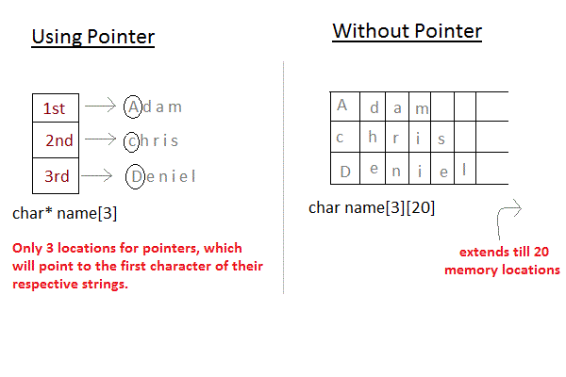
Array of Pointers
We can also have array of pointers.
Pointers are very helpful in handling character array with rows of varying length.
Example:
char *name[3] = {
"Adam",
"chris",
"Deniel"
};
//Now lets see same array without using pointer
char name[3][20] = {
"Adam",
"chris",
"Deniel"
};
Source: https://www.studytonight.com/c/pointers-with-array.php

Slide 11
In the second approach memory wastage is more, hence it is prefered to use pointer in such cases.
Note: When we say memory wastage, it doesn't means that the strings will start occupying less space, no, characters will take the same space, but when we define array of characters, a contiguous memory space is located equal to the maximum size of the array, which is a wastage, which can be avoided if we use pointers instead.

Slide 12
Example: Array of Pointers
#include <stdio.h>
const int MAX = 3;
int main ()
{
int var[] = {10, 100, 200};
int i;
for (i = 0; i < MAX; i++)
{
printf("Value of var[%d] = %d\n", i, var[i] );
}
return 0;
}
Output:
Value of var[0] = 10
Value of var[1] = 100
Value of var[2] = 200

Slide 13
Call by Value Vs Call by Address
Call by Value | Call by Reference
The actual arguments can be variable or constant. | The actual arguments can only be variable.
The values of actual argument are sent to formal argument which are normal variables. | The reference of actual argument are sent to formal argument which are pointer variables.
Any changes made by formal arguments will not reflect to actual arguments. | Any changes made by formal arguments will reflect to actual arguments.

Slide 14
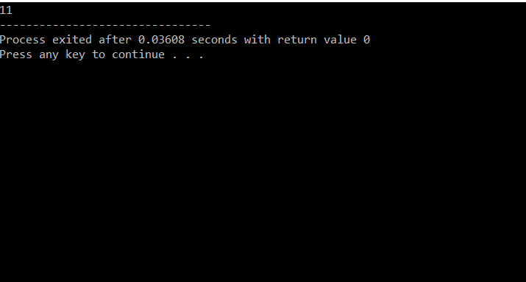
Example: Passing Pointers to Functions
#include <stdio.h>
void addOne(int* ptr) {
(*ptr)++; // adding 1 to *ptr
}
int main()
{
int* p, i = 10;
p = &i;
addOne(p);
printf("%d", *p); // 11
return 0;
}
Output:

Slide 15
Explanation of the Program:
Here, the value stored at p, *p, is 10 initially.
We then passed the pointer p to the addOne() function. The ptr pointer gets this address in the addOne() function.
Inside the function, we increased the value stored at ptr by 1 using (*ptr)++;. Since ptr and p pointers both have the same address, *p inside main() is also 11.

Slide 16
Function Returning a Pointer
Like normal variable, a function can also return reference or address. When function returns reference or address, the return type of function must be pointer type.
Syntax for function returning pointer:
return-type *function-name(argument list)
{
- - - - - - - - - -
body of function
- - - - - - - - - -
}

Slide 17
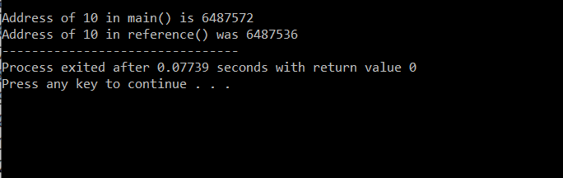
Example: Write a C program for function returning pointer
#include<stdio.h>
int *reference(int);
main()
{
int A=10;
int *ptr;
printf("\nAddress of %d in main() is %u",A,&A);
ptr = reference(A);
printf("\nAddress of %d in reference() was %u",A,ptr);
}
int *reference(int n)
{
return &n;
}
Output:

Slide 18
A function can also return a pointer to the calling function.
In this case you must be careful, because local variables of function doesn't live outside the function.
They have scope only inside the function.
Hence if you return a pointer connected to a local variable, that pointer will be pointing to nothing when the function ends.

Slide 19
Summary
C programming allows passing a pointer to a function. To do so, simply declare the function parameter as a pointer type.
In call by value method, the value of the actual parameters is copied into the formal parameters.
When an array is declared, compiler allocates sufficient amount of memory to contain all the elements of the array.
C also allows to return a pointer from a function.
In call by reference, the address of the variable is passed into the function call as the actual parameter.

Slide 20
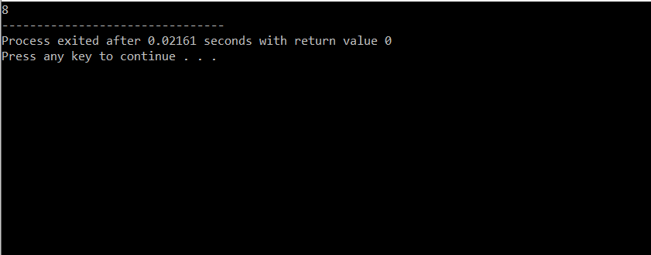
Frequently Asked question
Q1:What will the Output of the Program?
#include<stdio.h>
int main()
{
printf("%d", sizeof(void *));
return 0;
}
Output:

Slide 21
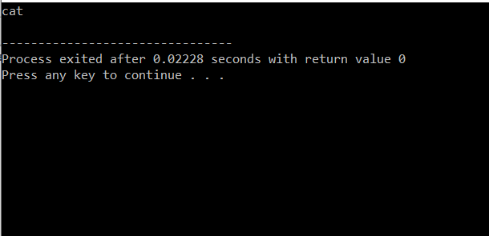
2) What will be the Output?
#include<stdio.h>
void function(char**);
int main()
{
char *arr[] = { "ant", "bat", "cat", "dog", "egg", "fly" };
function(arr);
return 0;
}
void function(char **ptr)
{
char *ptr1;
ptr1 = (ptr += sizeof(int))[-2];
printf("%s\n", ptr1);
}
return (0);}
Output:

Slide 22
Q3) What is “&” and “*” operators in C?
Ans:
1. “*” Operator is used as pointer to a variable. Example: * a where * is pointer to the variable a.
& operator is used to get the address of the variable. Example: &a will give address of a.
Q4) WHAT IS VOID POINTER IN C?
Ans:
Void pointer is a generic pointer that can be used to point another variable of any data type.
Void pointer can store the address of variable belonging to any of the data type. So, void pointer is also called as general purpose pointer.

Slide 23
Assessment Questions:
What will be the output of the C program?
#include<stdio.h>
int main(){
int a = 25, b;
int *ptr, *ptr1;
ptr = &a;
ptr1 = &b;
b = 36;
printf("%d %d",*ptr, *ptr1);
return 0;
}
2. What will be the output of the C program?
#include<stdio.h>
int main(){
int * ptr ;
printf("%d", sizeof(ptr));
return 0;
}

Slide 24
3. What will be the output of the C program?
#include<stdio.h>
int main()
{
char *str = "His";
int i;
for(i = 0; i < strlen(str); i++)
printf("%s", str++);
return 0;
}

Slide 25

Discussion forum.
Write a program in C to add numbers using call by reference.

Slide 26

REFERENCES
Reference Books
Programming in C by Reema Thareja.
Programming in ANSI C by E. Balaguruswamy, Tata McGraw Hill.
Programming with C (Schaum's Outline Series) by Byron Gottfried Jitender Chhabra, Tata McGraw Hill.
The C Programming Language by Brian W. Kernighan, Dennis Ritchie, Pearson education.
Websites:
https://www.programiz.com/c-programming/c-pointer-functions
https://www.studytonight.com/c/pointer-with-function-in-c.php
http://www.tutorialdost.com/C-Programming-Tutorial/17-C-Pointers.aspx
YouTube Links:
http://www.digimat.in/nptel/courses/video/106104128/L38.html

Slide 27
THANK YOU

